Slide 1
Introduction to Deep Generative Models-Part I
Yadong Lu
Mar 8. 2019

Slide 2
Content
Background: what is deep generative models?
Why generative models: application
Popular generative model architectures
Introduction to variational inference
Variational Auto-encoder (VAE)
Landscape of Current research in VAEs
Flexible variational distribution
The art of choosing prior for VAEs
Proper divergence metric
Mini-Project: implement a VAE

Slide 3
Background: What is deep generative models?
To model the data distribution and to generate data.
Different perspectives of generative models:
Supervised vs. unsupervised
Unlike other unsupervised learning methods, e.g. PCA, Kernel density estimation and clustering, deep generative models focusing on high dimensional data (image, text, speech) and generation.
Probabilistic model P(X) of the data X: Maximum likelihood (flow based model)
Distance Minimization: Finding a generative distribution q(X) that is closest to the data distribution (VAEs, GANs)

Slide 4
Why deep generative models? -Applications
Richard Feynman: “What I cannot create, I do not understand”
Question and discussion: What can generative model do in terms of real world application?

Slide 5
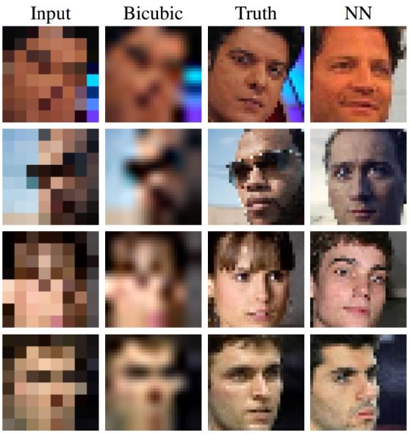
Why deep generative models? -Applications
Image Super-Resolution

Slide 6
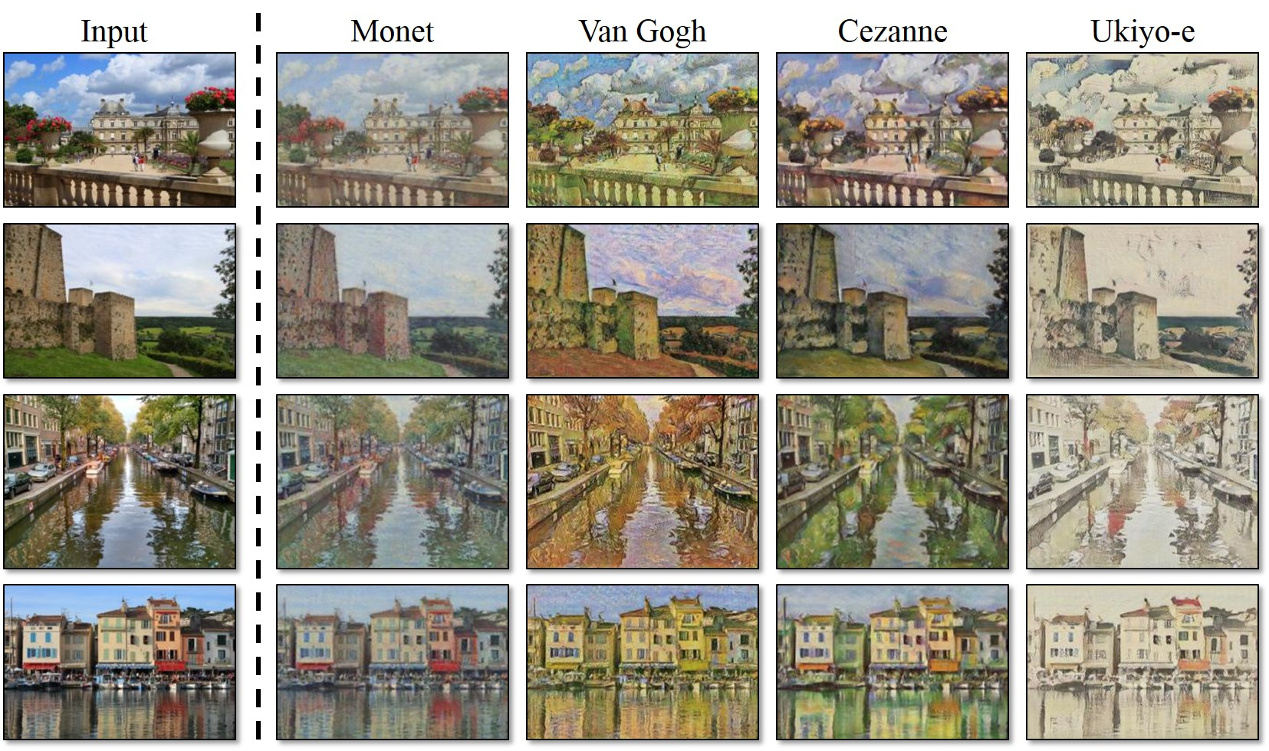
Why deep generative models? -Applications
Image style transfer:
https://github.com/junyanz/CycleGAN

Slide 7
Why deep generative models? -Applications
Machine Translation/Speech synthesis
https://ai.googleblog.com/2016/09/a-neural-network-for-machine.html

Slide 8
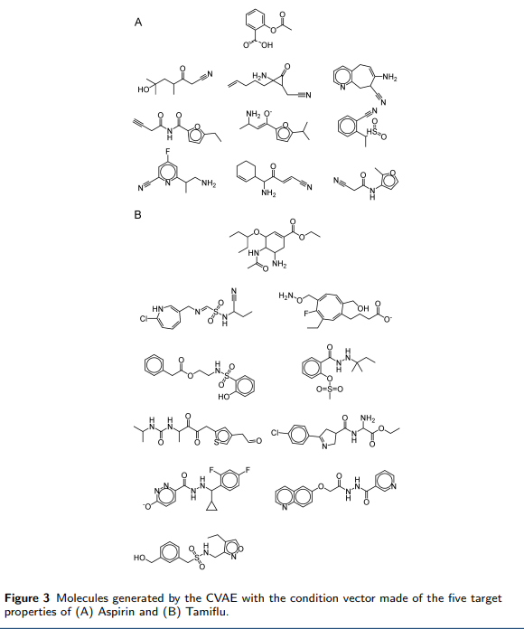
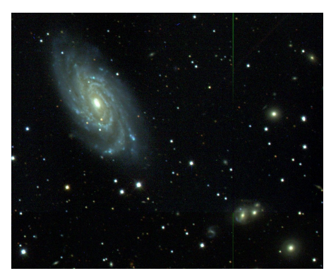
Why deep generative models? -Applications
Application in Science:
Molecule Design: Lim et al. (2018)
Astronomy: Locating Celestial Bodies. Regier et al., (2015)

Slide 9
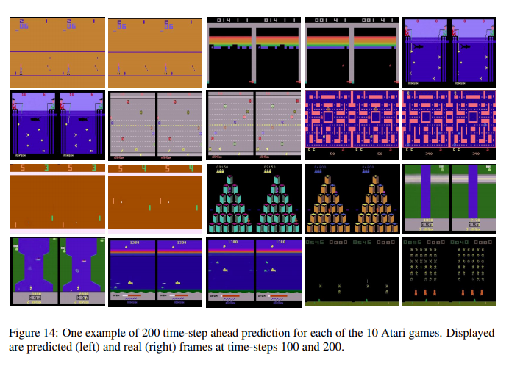
Why deep generative models? -Applications
Reinforcement Learning: Future Simulation
Chiappa, 2017

Slide 10
Popular generative model architectures
ML algorithm = Model + Learning principle
Variational Auto-encoders (VAE) (2013)
Encoder decoder structure
Convenient inference
Blurry image
Generative Adversarial Networks (GAN) (2014)
High quality image
Hard to train/unstable/mode collapse
Flow based model (2015)
High quality image
Explicit likelihood
Memory intensive
Variational Lower Bound
JS-distance
Maximizing Likelihood

Slide 11
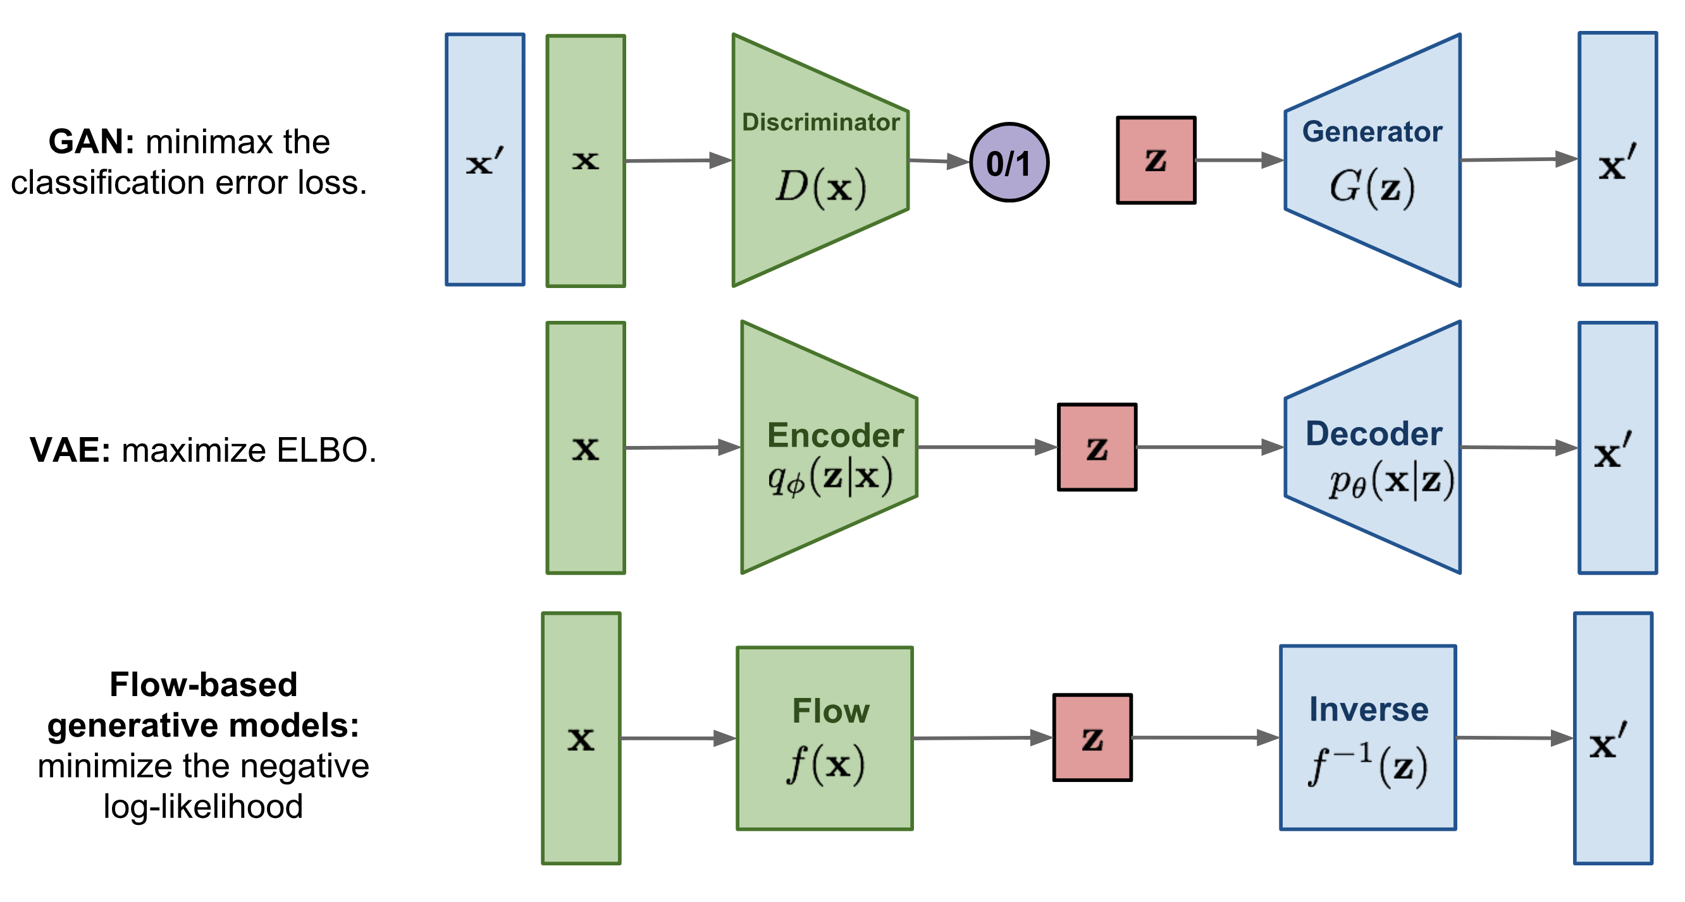
Popular generative model architectures
https://lilianweng.github.io/lil-log/2018/10/13/flow-based-deep-generative-models.html#realnvp

Slide 12


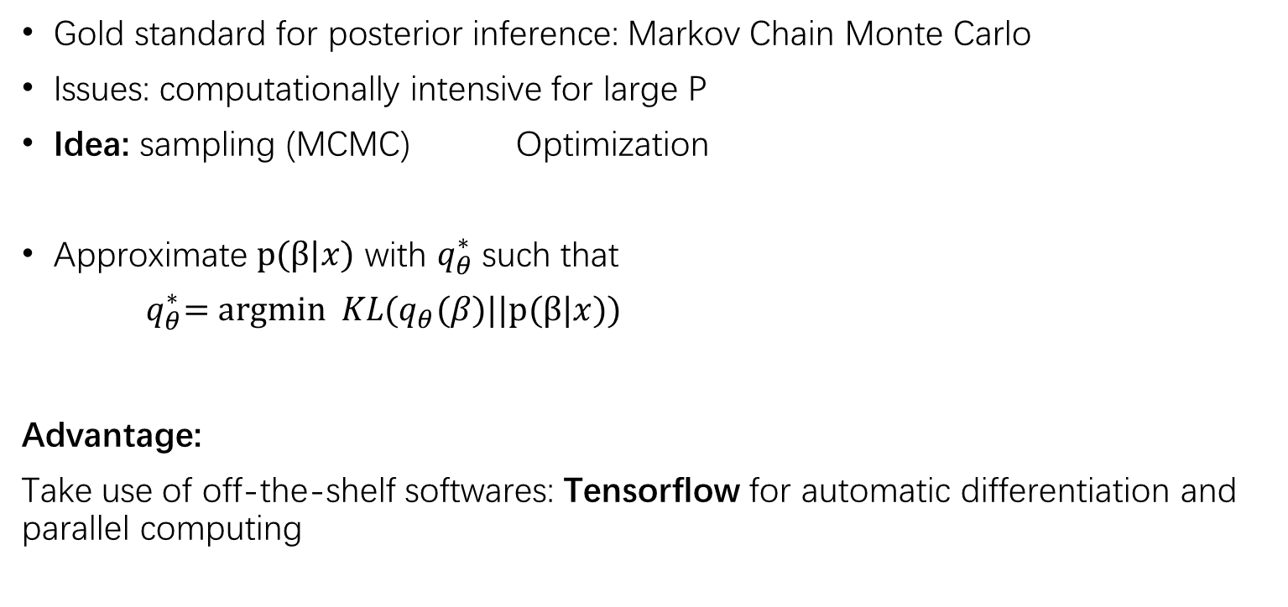
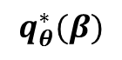

Variational Inference
Gold standard for posterior inference: Markov Chain Monte Carlo
Issues: computationally intensive for large P
Idea: sampling (MCMC) Optimization
Approximate $p(β|x)$ with $q_{θ}^{∗}$ such that
${ q}_{θ}^{∗}=argmin KL(q_{θ}(β)||p(β|x))$
Advantage:
Take use of off-the-shelf softwares: Tensorflow for automatic differentiation and parallel computing
$p\left(β | x\right)$ $\text{•}$
$$\text{•}$$
$$q_{θ}^{∗}(β)$$

Slide 13
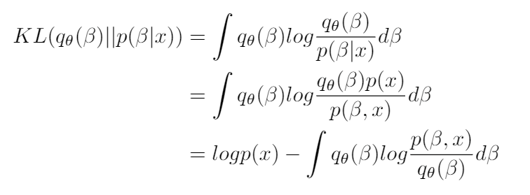
Variational Inference
Idea: sampling (MCMC) Optimization
Evidence Lower Bound (ELBO)
Minimizing KL Maximizing ELBO

Slide 14
Amortized Variational Inference
Idea: let the variational parameter be dependent on the input X
Structure:
Encoder (Recognition network)
Decoder (Reconstruction network)

Slide 15
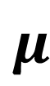
Sampling
. . .
. . .
. . .
. . .
$$μ$$
z
Latent Space
x
Recognition
Network
Reconstruction
Network
X’

Slide 16
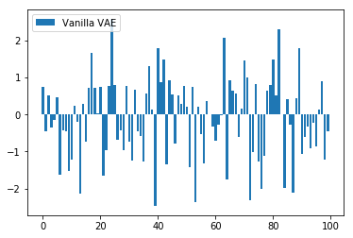
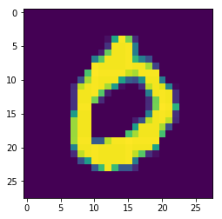
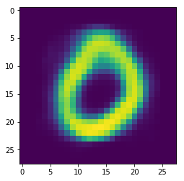
Recongition Network
Latent Space
Sample
Reconstruction Network

Slide 17
An example of generated images

Slide 18
Amortized Variational Inference
Idea: let the variational parameter be dependent on the input X
Structure:
Encoder (Recognition network)
Decoder (Reconstruction network)
Stochastic Variational Inference
Reparameterization trick (Kingma and Welling. 2013)
Exercise: Deriving the objective function: Evidence Lower Bound for VAE

Slide 19
Current research in VAEs
What are the drawbacks that need to be addressed for VAE models?

Slide 20
Current research in VAEs
What are the drawbacks that need to be addressed for VAE models?
Blurry Image
Over regularization of the latent space

Slide 21
Current research in VAEs
Flexible variational distribution:
Implicit Variational Inference:
Variational Inference with Normalizing Flows. Rezende and Mohamed, 2016
Semi-Implicit Variational Inference. Yin and Zhou, 2018
Unbiased Implicit Variational Inference. Titsias and Ruiz, 2018

Slide 22
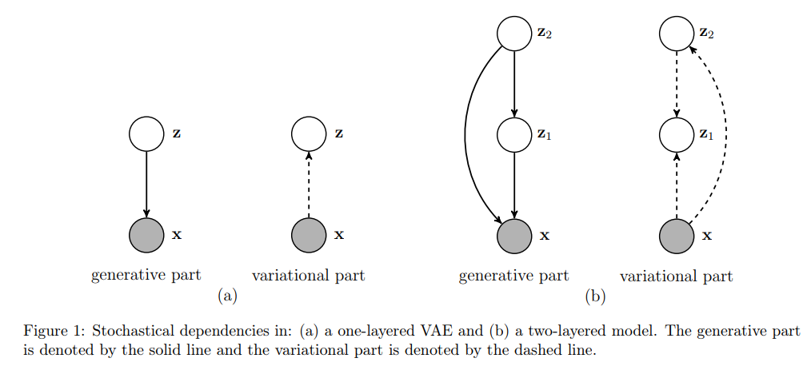
Current research in VAEs
The art of choosing prior for VAEs – structural prior
VAE with a VampPrior. Tomczak and Welling, 2017
Hierarchical
Coupling Posterior

Slide 23
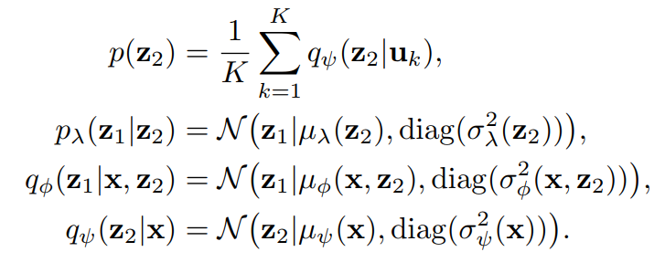
Current research in VAEs
The art of choosing prior for VAEs - structural prior
VAE with a VampPrior. Tomczak and Welling, 2017

Slide 24
Current research in VAEs
The art of choosing prior for VAEs – allowing dynamic latent space dimension
Stick-breaking prior (Nalisnick, 2016)
Tackling over-pruning of VAE (Yeung, 2017)
Sparsity inducing prior (Lu, 2019)

